Slide 1
IO500 Bof @ SC19
CJ Newburn and team

Slide 2
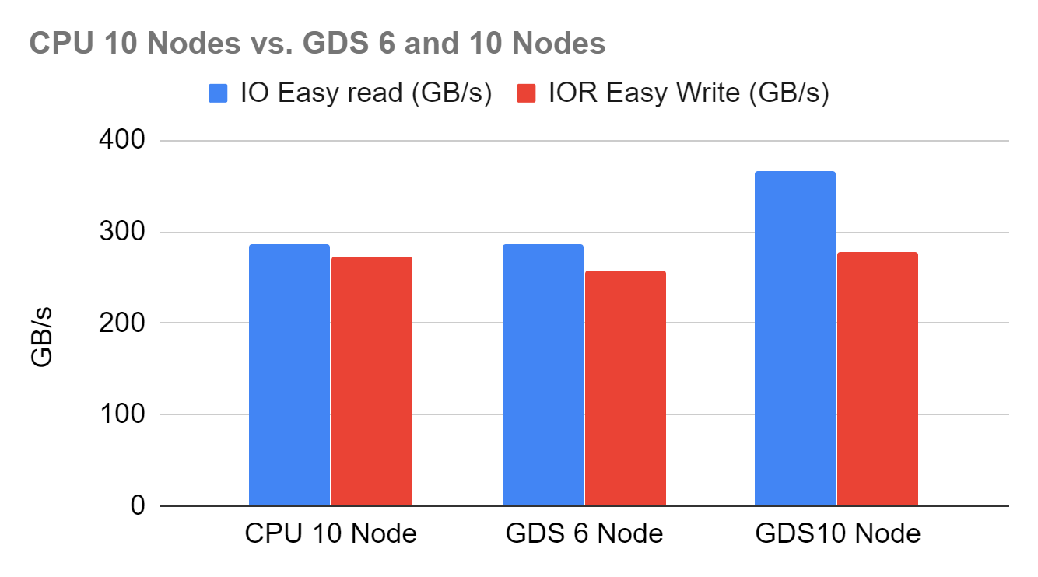
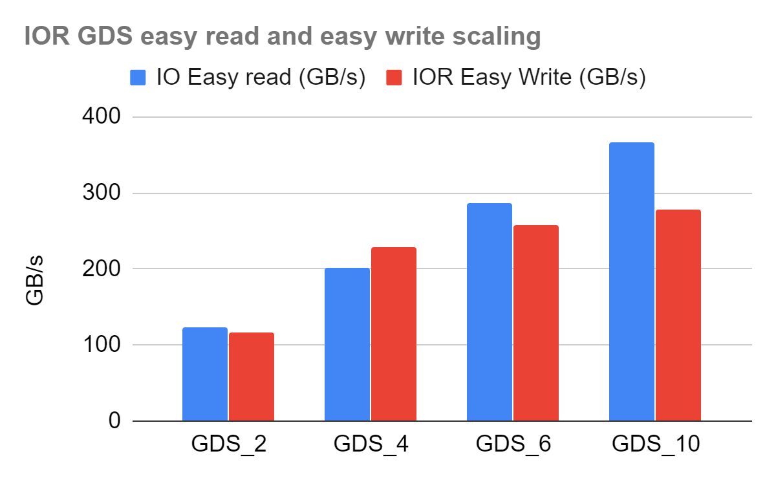
A direct path to accelerated compute
IO to compute dominates
DGX-2: 16 GPUs, 8 NICs, 2 CPUs
Move data directly to GPUs
Relieve CPU bottleneck
6 or 10 DGX-2s,
10 DDN A31 AI400X
GDR for IOR easy
Notes:
Threads: CPU 10/40, GDS 2,4,6/96, 10/80
GDS 6 was similar but not the same as CPU
BW was up to 424 GB/s before trailing off while waiting for the last guy
Writes being a bit lower could be due to fragmentation since trimming

Slide 3
FOR the community
Compete on 10 client with fewer nodes?
Select the target of the IO, e.g. GPU?
Tune threads per use case tested?
New specializations, e.g. for deep learning’s granular random reads and burst writes
Notes:
Spec SFS SP3? DL: 128K/2M random reads, 100MB writes

