Slide 1
IO500 on Bancho Cluster of Exascaler/Lustre
Shuichi Ihara

Slide 2
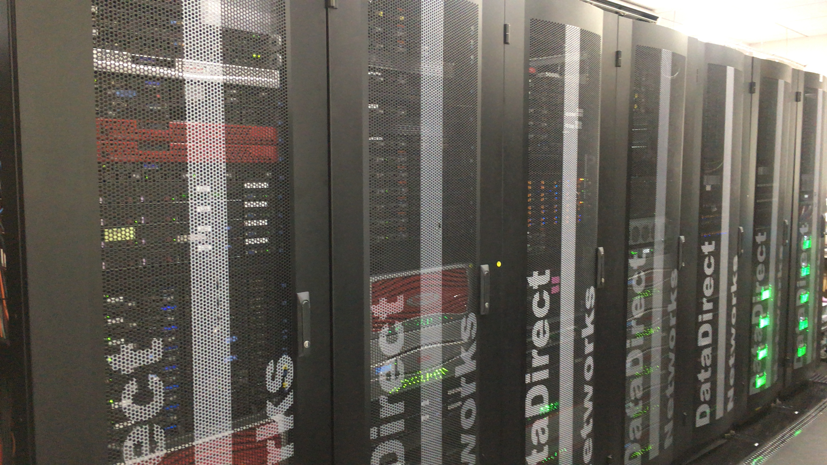
About “Bancho” Cluster
Cluster locates at DDN Tokyo office in Japan
Benchmark lab opened in 2010 after started DDN business in Japan, 2008
Various Storage, Server and network configuration
Co-located Whamcloud Lustre Performance engineering
Focused on IO benchmark
Customer IO Benchmark and POC
Strategic IO performance benchmark
New H/W technology and new version of software
IO Performance analysis and optimization

Slide 3
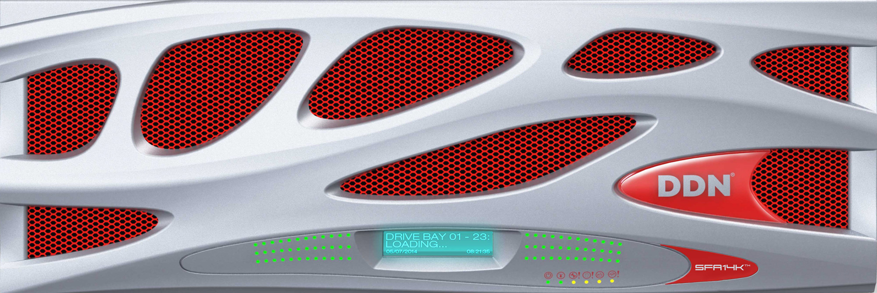
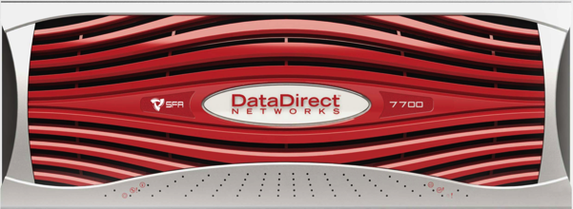
DDN IO-500 Exascaler 5.0 (PRE) Test Configuration
10 x Client
MDS/MDT | 4 x MDS 1x Platinum 8160, 96GB RAM, 1 x IB EDR 1 x SFA7700 FC 2 x MDT(2 x RAID1 SSD) per MDS
OSS/OST | 1 x ES14K + 5 x SS9012 408 x NL-SAS 10TB 8 x DCR POOL (51/MR=1) 4 x vOSS(8 CPU Core, 90GB RAM, 1x IB EDR
Client | 10 x Intel Server 2 x E5-2650v4, 128GB RAM, 1x IB EDR CentOS7.4
Software | Pre-Exascaler5.0 master branch for lustre-2.12
IB EDR
4 x MDS
ES14K
1 x SFA7700FC
5 x SS9012

Slide 4
Hardware resource ratio of Bancho cluster
Total aggregate hardware resource on server and client
Aggregate storage device bandwidth against storage network bandwidth
Storage devices 101GB/s(254MB/s x 400 HDD) > storage network 50GB/sec (100Gbps x 4 OSS)
Bottleneck on storage network bandwidth
 | Client | Sever | Server/Client
CPU Core | 240 (24 x 10 Client) | 128 (8 x 4 OSS, 24 x 4 MDS) | 50%
RAM(GB) | 1280 (128 x 10 Client) | 744 (90 x 4 OSS, 96 x 4 MDS) | 58%
Network Bandwidth(Gbps) | 1000 (100 x 10 Client) | 400 + 400(100 x 4 OSS, 100 x 4 MDS) | 40%

Slide 5
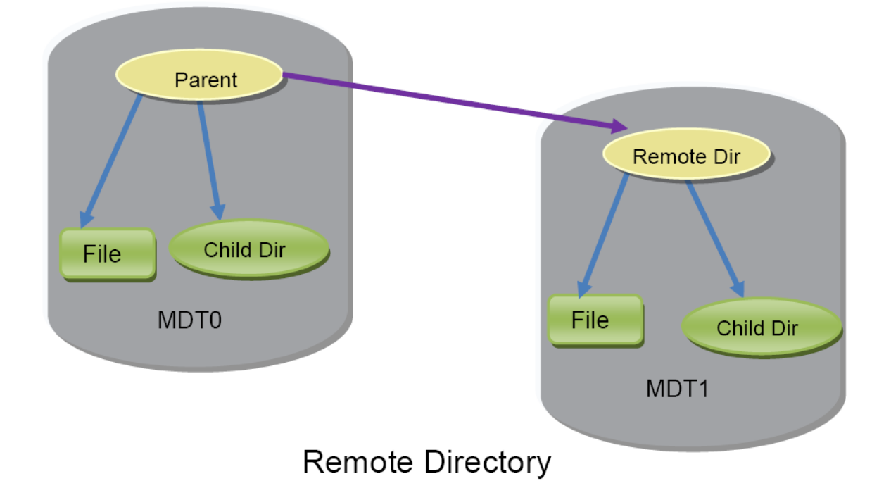
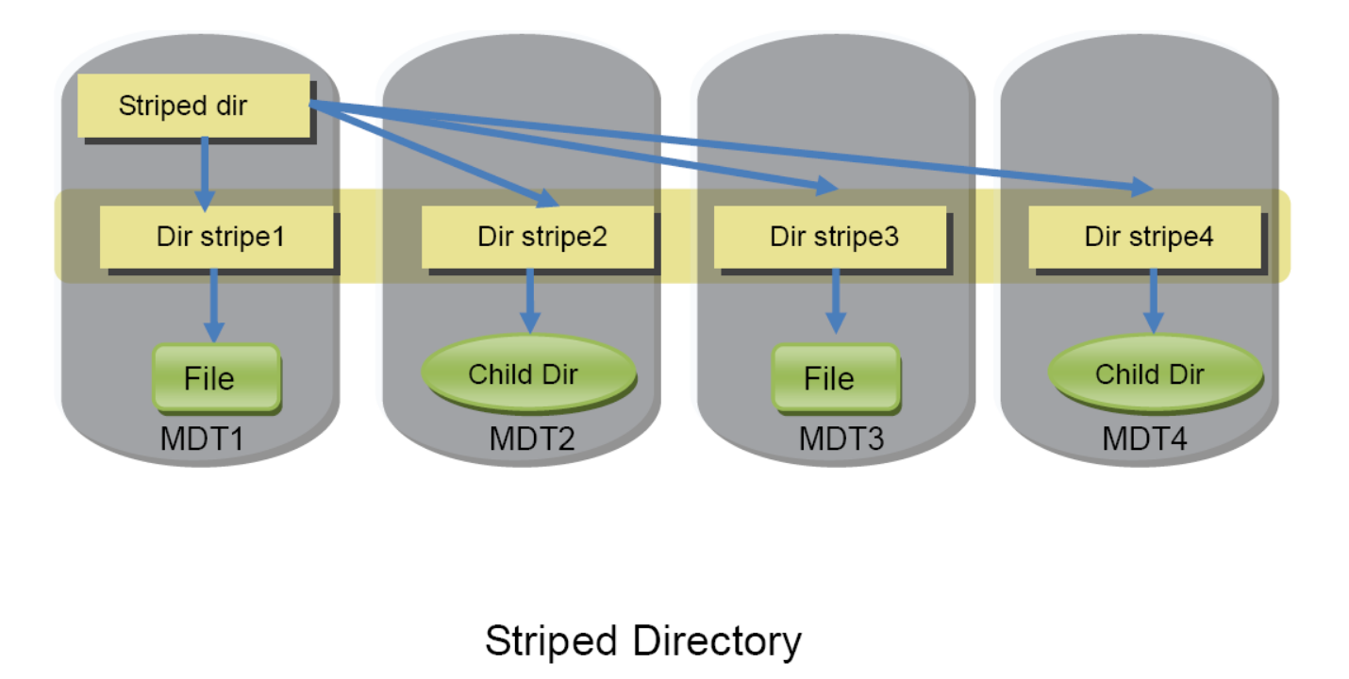
Lustre Tuning/Configuration Striped Directory for metadata performance
Lustre supports two type of Distributed metadata
Remote Directory(DNE1) and Striped Directory(DNE2)
Single MDS and MDT by default
Enable DNE with “lfs setdirstripe” command
# lfs setdirstripe -c 4 /scratch0/io500
# lfs setdirstripe -c 4 -D /scratch0/io500

Slide 6
Lustre Tuning/Configuration Other Tips
Client Side setting
# lctl set_param \
osc.*.max_pages_per_rpc=16M \
osc.*.max_rpcs_in_flight=16 \
llite.*.max_read_ahead_mb=2048 \
osc.*.checksums=0
Server Side setting
# lctl set_param \
osd-ldiskfs.*.read_cache_enable=0
obdfilter.*.writethrough_cache_enable=0
That’s all changed parameters and configuration from default Exascaler setting.
Sending more aggressive RPCs to server and readahead
Avoiding Page Cache on OSS when it flush data to flush

Slide 7
DDN IO-500 Exascaler 5.0 (PRE) Score for 10 Client Configuration Challenge
[RESULT] BW phase 1 ior_easy_write 37.540 GB/s : time 343.38 seconds
[RESULT] IOPS phase 1 mdtest_easy_write 199.685 kiops : time 325.87 seconds
[RESULT] BW phase 2 ior_hard_write 0.262 GB/s : time 300.21 seconds
[RESULT] IOPS phase 2 mdtest_hard_write 24.348 kiops : time 395.55 seconds
[RESULT] IOPS phase 3 find 3332.110 kiops : time 21.96 seconds
[RESULT] BW phase 3 ior_easy_read 35.374 GB/s : time 364.41 seconds
[RESULT] IOPS phase 4 mdtest_easy_stat 527.669 kiops : time 124.08 seconds
[RESULT] BW phase 4 ior_hard_read 4.627 GB/s : time 17.03 seconds
[RESULT] IOPS phase 5 mdtest_hard_stat 79.476 kiops : time 106.64 seconds
[RESULT] IOPS phase 6 mdtest_easy_delete 226.094 kiops : time 288.22 seconds
[RESULT] IOPS phase 7 mdtest_hard_read 46.141 kiops : time 182.72 seconds
[RESULT] IOPS phase 8 mdtest_hard_delete 58.842 kiops : time 143.64 seconds
[SCORE] Bandwidth 6.33725 GB/s : IOPS 159.413 kiops : TOTAL 31.7843

Slide 8
Conclusions
IO-500 on Exascaler/Lustre was one of good exercise
Good opportunity try Lustre DNE2 out and confirmed it worked very well.
Happy to test with DoM(Data on Metadata) or other new Lustre features next time. ☺
Might be good a regression benchmark toolset as well.
More normalization would be nice to have
10 client challenge was good start, but doesn’t see storage side configuration detail.
At least, we may see “score / Total aggregated H/W resource”
Good motivation on improving efficiency and eventually it could be good score/cost.

